Slide 1
Coursera Capstone project
Coursera IBM Data Science Certification

Slide 2
Report Content
1. Introduction Section :
⁃ The “business problem” to be solved by this project and who may be interested
2. Data Section:
⁃ Describe Data requirements and Sources needed to solve the problem
3. Methodology section:
⁃ Main component of the report - Execute data processing, describe/discuss any exploratory data analysis and/or inferential statistical testing performed, and/or machine learnings used.
4. Results section:
⁃ Discussion of the results and finding of answer
5. Discussion section:
⁃ Discussion of observations noted and any recommendations
6. Conclusion section:
⁃ Answer chosen and conclusions.

Slide 3
Introduction
1.1 Scenario and Background
I need to establish a restaurant for Gusine Catering in Kristiansand city in Norway:
This is Gusine Catering’s business problem to choose of the first neighborhood to offer services.
Problem to be resolved:
• The neighborhood should enable easy replication.
• The neighborhood should have high demand.
• The neighborhood should have lower competition.
• Success Criteria:
• Good recommendation of neighborhood that meets above points.
• It should have capability to enable latest information whenever required.
Interested Audience
I believe the methodology, tools and strategy used in this project is relevant for a person or entity considering to establish a food business in Kristiansand city.The use of FourSquare data and mapping techniques combined with data analysis will help resolve the key questions arisen. Lastly, this project is a good practical case for a person developing Data Science skills.

Slide 4
Data Section
2.1 Data Requirements
For this project we need the following data :
Resturants data that contains list Locality, Resturant name,Rating along with their latitude and longitude.
2.2 Data Sources, Data Processing and Tools used
This data set contains the required information. And we will use this data set to explore various locality of Kristiansand city.
Nearby places in each locality of the city.
Data source : Fousquare API
Description : By using this api we will get all the venues in each neighborhood.
• Data Requirements for this project:
• Neighborhood Information (i.e. name, coordinates, populations).
• Venue information (i.e. name, category, coordinates)
• Data Processing for this project:
• Data cleaning is required
• Data needs to be in a structured format

Slide 5
Methodology
The Strategy to find the answer:
• Data Scrapping Technique
• To scrap the neighborhood data from Wikipedia
• To make the data into a structured format
• Foursquare.com
• Retrieving venue information from above API.
• K-Means Machine Learning
• Segment and cluster similar neighborhoods
• Group them based on most common venues
• Scoring Weightage
• Population count has 50% weightage
• Venue (fewer grocery) has another 50% weightage

Slide 6
Execution and Results

Slide 7
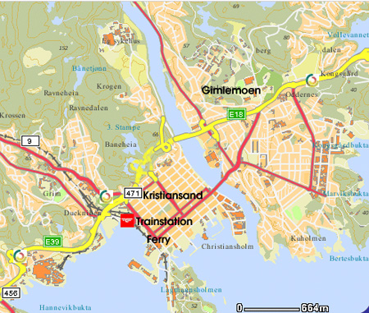
Current residence Neighborhood in Kristiansand

Slide 8
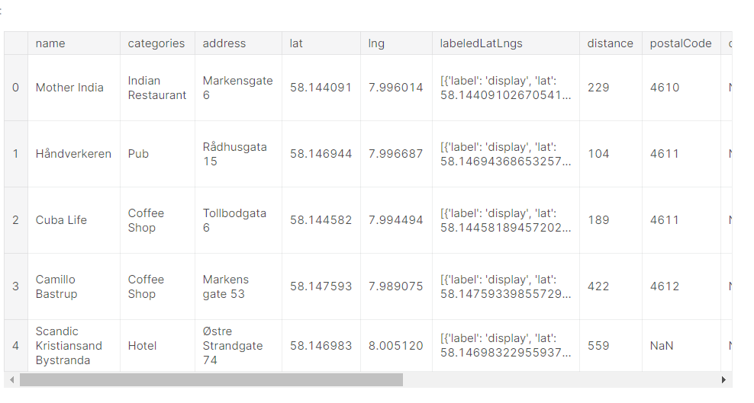
Venues around Neighborhood in

Slide 9
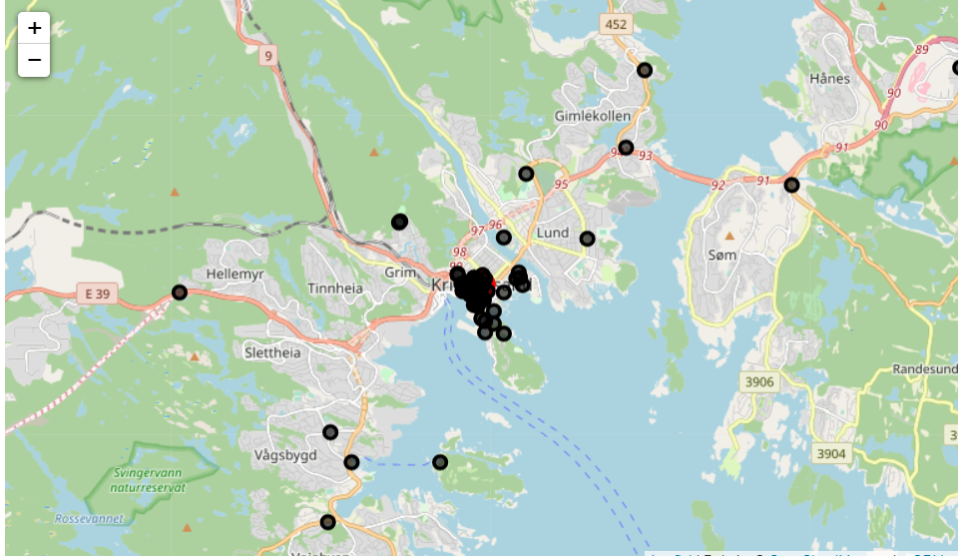
Kristiansand Map - Neighborhoods and Cluster of Venues

Slide 10
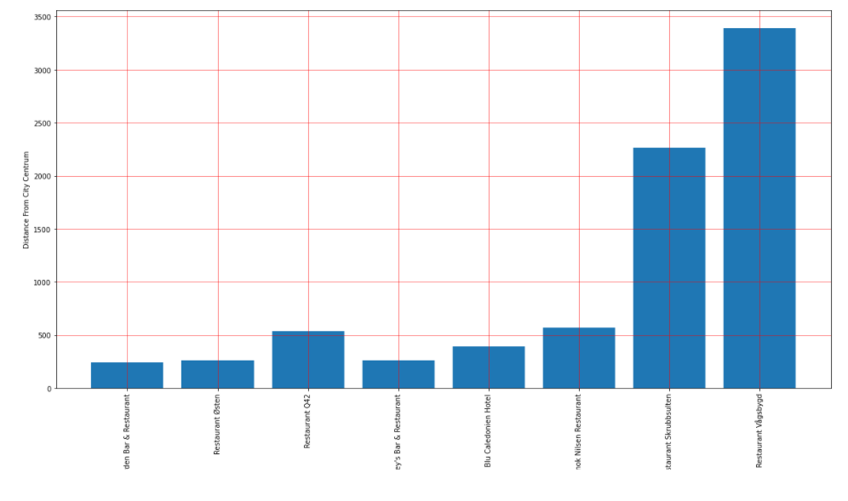
Statistics of restaurants by their distance to venues

Slide 11
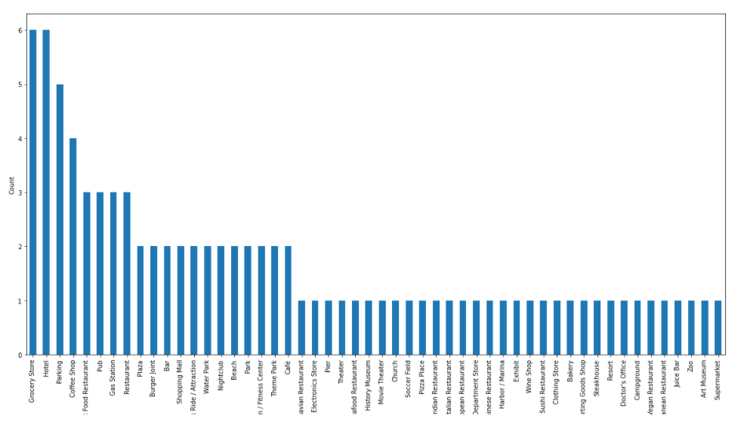
Statistics of venues in the city

Slide 12
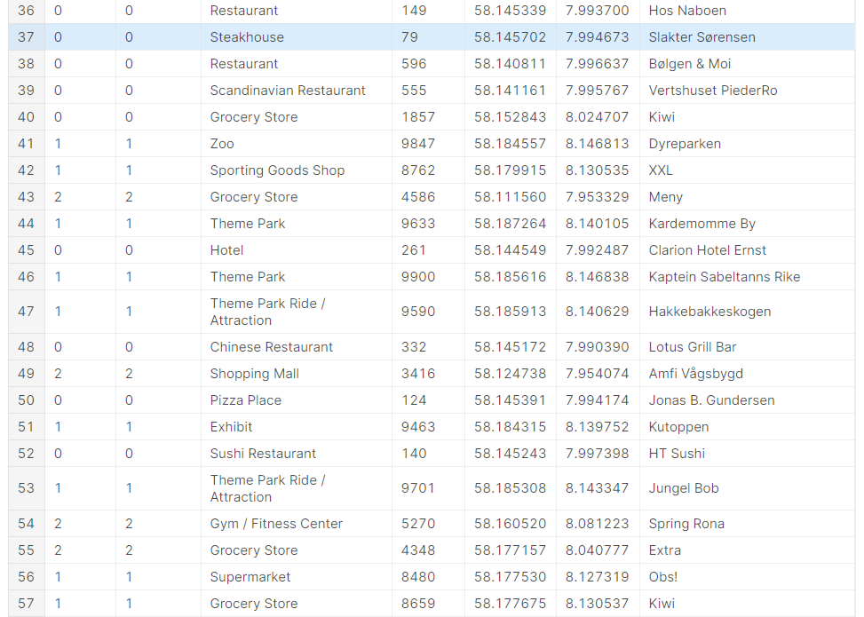
Clusters of venues in kristiansand

Slide 13
Discussion
From above reports, we could get an idea why the predicted one is pointed/clustered on the red spots which is the center of attraction for the place where we can establish our restaurant.
KMeans have figured out the most common place for all the venues.
This output was very adjacent to the core location.
This proves the accurate spotting of our predicted algorithm.

Slide 14
6.0 Conclusions
As a result,one can set up a hotel/restaurant around given red spot. This will bring revenue automatically as we have located in very near to core one which is proved by Kmeans.
This project has shown me a practical application to resolve a real situation that has impacting personal and financial impact using Data Science tools.
The mapping with Folium is a very powerful technique to consolidate information and make the analysis and decision thoroughly and with confidence. I would recommend for use in similar situations.

